Slide 1
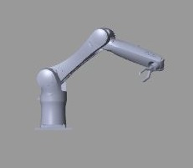
ME41020 Space Robotics Group 17 KUKA KR10
Roel Djajadiningrat
Martin Kooper
Jeffrey Minnaard
Nick Tsutsunava

Slide 2
Contents
Denavit–Hartenberg parameters
Forward Kinematics
Inverse Kinematics
Trajectory Planning
GUI & Simulink
Demonstration

Slide 3
Contents
Denavit–Hartenberg parameters
Forward Kinematics
Inverse Kinematics
Trajectory Planning
GUI & Simulink
Demonstration

Slide 4
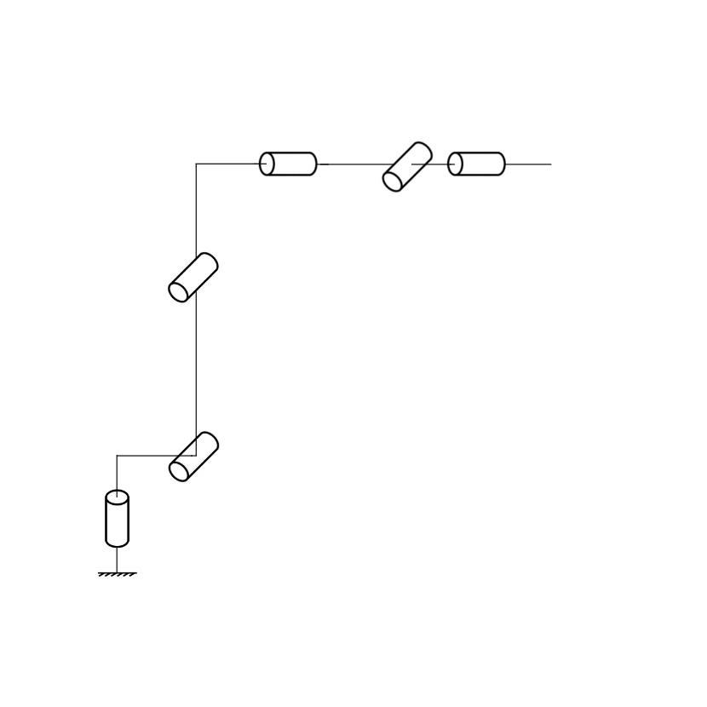
Denavit–Hartenberg parameters
6-DOF
Manipulator

Slide 5
Denavit–Hartenberg parameters
Label joint axis
x_{i} along common normal of z_{i-1} and z_{o}
Establish y with right hand frame

Slide 6
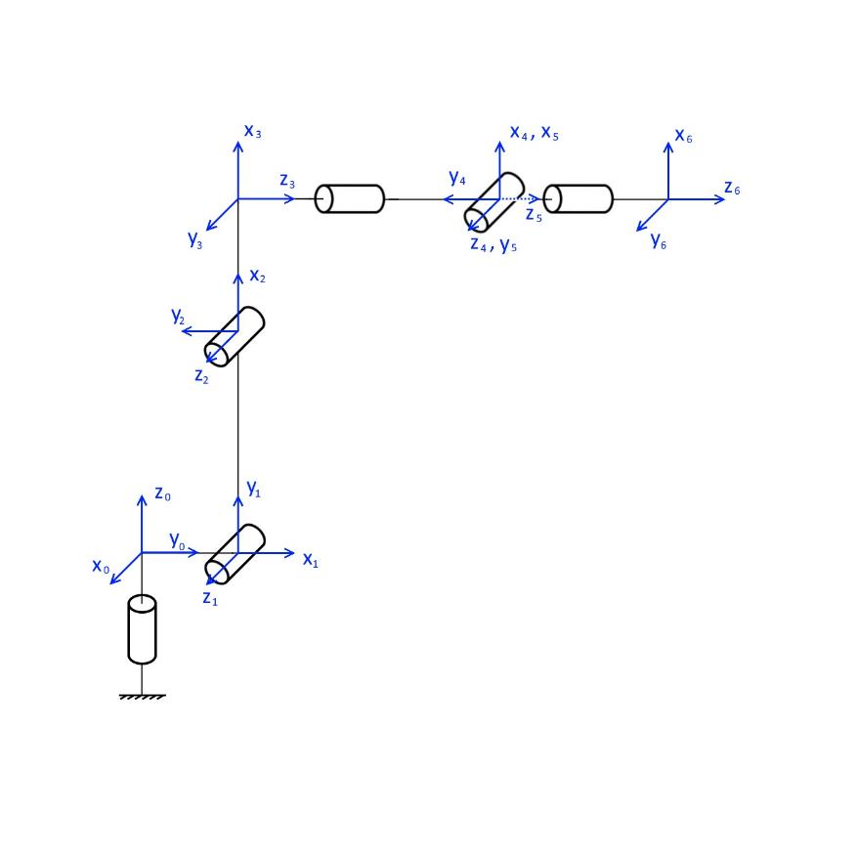
Denavit–Hartenberg parameters
Label joint axis
x_{i} along common normal of z_{i-1} and z_{o}
Establish y with right hand frame

Slide 7

Denavit–Hartenberg parameters
Link parameters

Slide 8
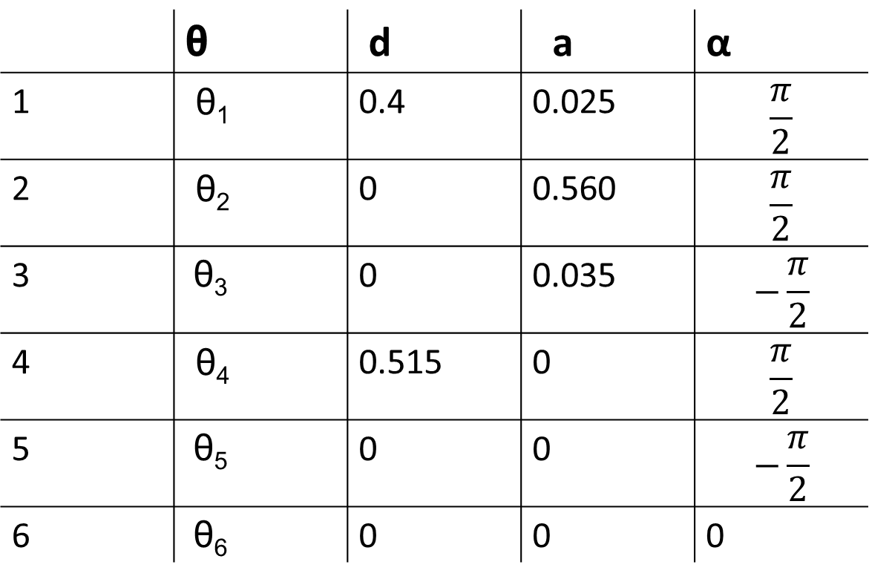
Denavit–Hartenberg parameters
Link parameters
 | θ | d | a | α
1 | θ₁ | 0.4 | 0.025 | $$\frac{π}{2}$$
2 | θ₂ | 0 | 0.560 | $$\frac{π}{2}$$
3 | θ₃ | 0 | 0.035 | $$−\frac{π}{2}$$
4 | θ₄ | 0.515 | 0 | $$\frac{π}{2}$$
5 | θ₅ | 0 | 0 | $$−\frac{π}{2}$$
6 | θ₆ | 0 | 0 | 0

Slide 9
Contents
Denavit–Hartenberg parameters
Forward Kinematics
Inverse Kinematics
Trajectory Planning
GUI & Simulink
Demonstration

Slide 10
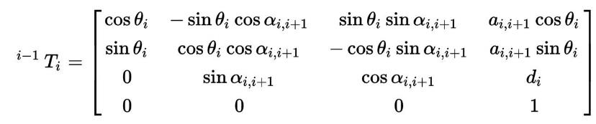
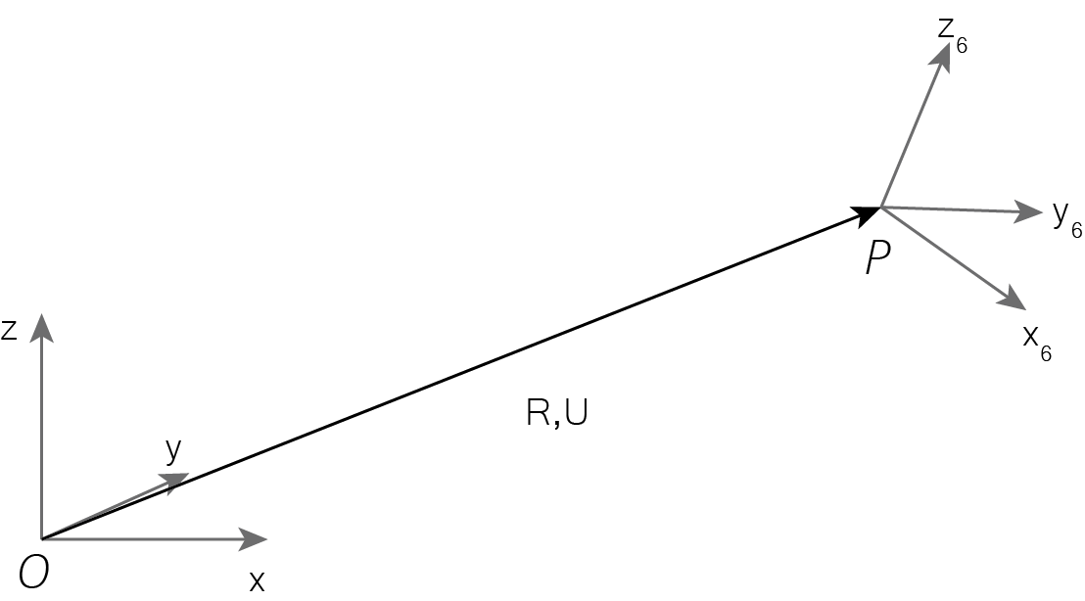
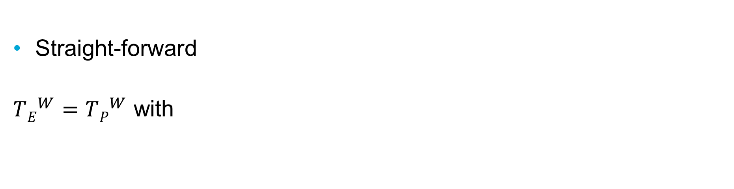
Forward Kinematics
Straight-forward
$TE^{W}=TP^{W}$ with

Slide 11
Contents
Denavit–Hartenberg parameters
Forward Kinematics
Inverse Kinematics
Trajectory Planning
GUI & Simulink
Demonstration

Slide 12
Inverse Kinematics
Input: XYZ-coordinates of end effector
Output: Joint angles
Paper by Alireza Khatamian
Gautam Sinha 6-axis robotic arm algorithm, modified
Tool head orientation with orientation vector
Khatamian, A. “Solving Kinematics Problems of a 6-DOF Robot Manipulator.” (2015).
Sinha, G. “Inverse Kinematics and path planning simulation for Robotic arm in MATLAB”

Slide 13
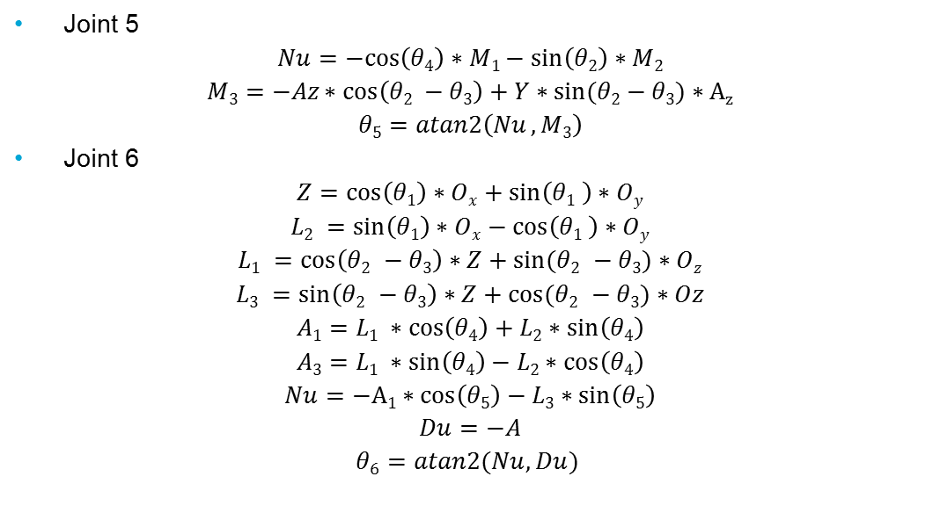
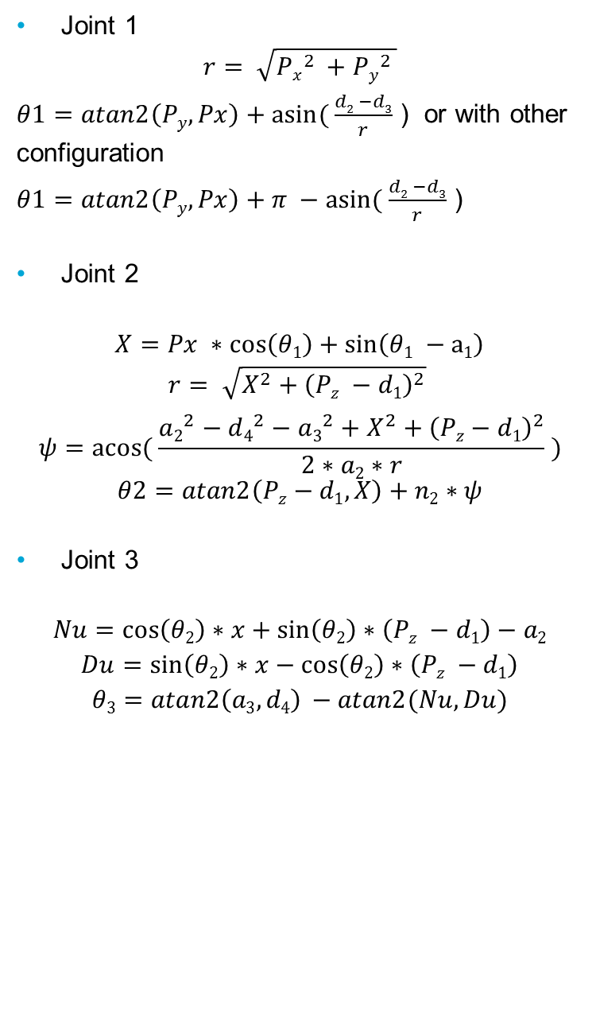
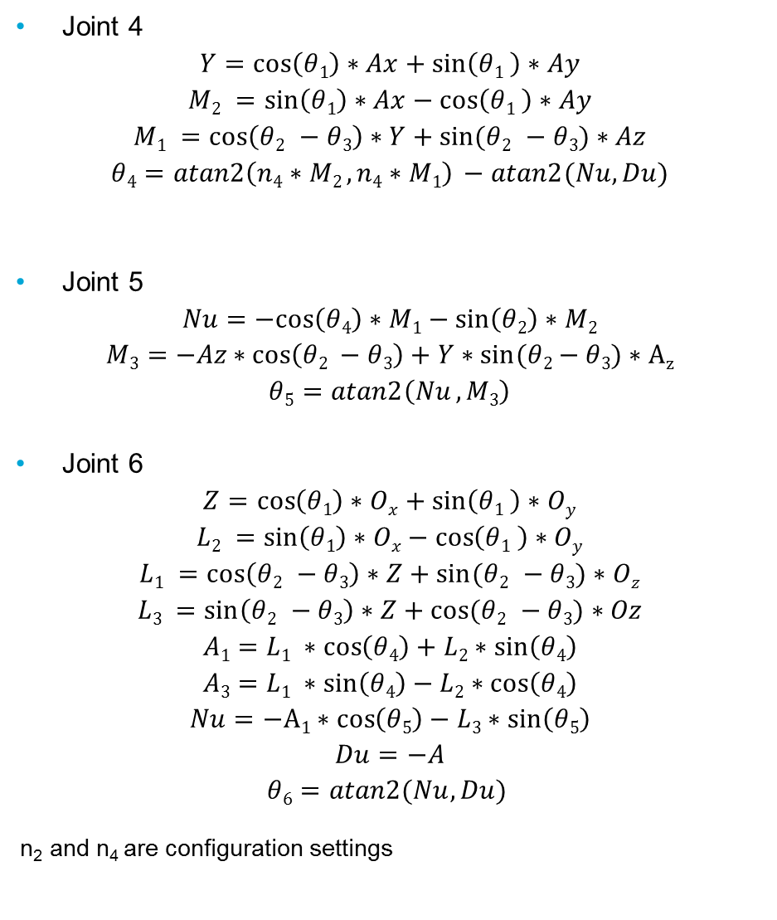
Joint 5
$$Nu=−cos\left(θ4\right)∗M1−\sin\left(θ2\right)∗M2$$
$$M3=−Az∗cos\left(θ2 −θ3\right)+Y∗sin⁡(θ2−θ3)∗Az$$
$$θ5=atan2\left(Nu , M3\right)$$
Joint 6
$$Z=\cos\left(θ1\right)∗Ox+\sin\left(θ1 \right)∗Oy$$
$$L2 =\sin\left(θ1\right)∗Ox−\cos\left(θ1 \right)∗Oy$$
$$L1 =\cos\left(θ2 −θ3\right)∗Z+sin⁡(θ2 −θ3)∗Oz$$
$$L3 =\sin\left(θ2 −θ3\right)∗Z+cos⁡(θ2 −θ3)∗Oz$$
$$A1=L1 ∗\cos\left(θ4\right)+L2∗\sin\left(θ4\right)$$
$$A3=L1 ∗\sin\left(θ4\right)−L2∗\cos\left(θ4\right)$$
$$Nu=−A1∗cos\left(θ5\right)−L3∗sin\left(θ5\right)$$
$$Du=−A$$
$$θ6=atan2(Nu,Du)$$
Inverse Kinematics
Joint 1
$$r= \sqrt{Px^{2 }+Py^{2 }}$$
$θ1=atan2\left(Py,Px\right)+asin⁡( \frac{d2 −d3}{r}$ ) or with other configuration
$θ1=atan2\left(Py,Px\right)+π −asin⁡( \frac{d2 −d3}{r}$ )
Joint 2
$$X=Px ∗\cos\left(θ1\right)+\sin\left(θ1 −a1\right)$$
$$r= \sqrt{X^{2}+{\left(Pz −d1\right)}^{2}}$$
$$ψ=acos⁡( \frac{a2^{2}−d4^{2}−a3^{2}+X^{2}+{\left(Pz−d1\right)}^{2}}{2∗a2∗r} )$$
$$θ2=atan2\left(Pz−d1,X\right)+n2∗ψ$$
Joint 3
$$Nu=\cos\left(θ2\right)∗x+\sin\left(θ2\right)∗\left(Pz −d1\right)−a2$$
$$Du=\sin\left(θ2\right)∗x−\cos\left(θ2\right)∗\left(Pz −d1\right)$$
$$θ3=atan2\left(a3,d4\right) −atan2(Nu,Du)$$
Joint 4
$$Y=\cos\left(θ1\right)∗Ax+\sin\left(θ1 \right)∗Ay$$
$$M2 =\sin\left(θ1\right)∗Ax−\cos\left(θ1 \right)∗Ay$$
$$M1 =\cos\left(θ2 −θ3\right)∗Y+sin⁡(θ2 −θ3)∗Az$$
$$θ4=atan2\left(n4∗M2 , n4∗M1\right) −atan2(Nu,Du)$$
Joint 5
$$Nu=−cos\left(θ4\right)∗M1−\sin\left(θ2\right)∗M2$$
$$M3=−Az∗cos\left(θ2 −θ3\right)+Y∗sin⁡(θ2−θ3)∗Az$$
$$θ5=atan2\left(Nu , M3\right)$$
Joint 6
$$Z=\cos\left(θ1\right)∗Ox+\sin\left(θ1 \right)∗Oy$$
$$L2 =\sin\left(θ1\right)∗Ox−\cos\left(θ1 \right)∗Oy$$
$$L1 =\cos\left(θ2 −θ3\right)∗Z+sin⁡(θ2 −θ3)∗Oz$$
$$L3 =\sin\left(θ2 −θ3\right)∗Z+cos⁡(θ2 −θ3)∗Oz$$
$$A1=L1 ∗\cos\left(θ4\right)+L2∗\sin\left(θ4\right)$$
$$A3=L1 ∗\sin\left(θ4\right)−L2∗\cos\left(θ4\right)$$
$$Nu=−A1∗cos\left(θ5\right)−L3∗sin\left(θ5\right)$$
$$Du=−A$$
$$θ6=atan2(Nu,Du)$$
n₂ and n₄ are configuration settings

Slide 14
Contents
Denavit–Hartenberg parameters
Forward Kinematics
Inverse Kinematics
Trajectory Planning
GUI & Simulink
Demonstration

Slide 15
Trajectory Planning
Interpolates location between one or more points in cartesian space
Control the spacing between locations using sigmoidal membership function (SMF). Depends on Vmax and easing parameter
Avoids circle with small radius so EEF does not pass through base
Run IK for all locations
+ Can describe EEF path
+ Control EEF velocity
+ Easy to extend to path planning
- No control over joint velocity
- No easy control for joint constraints
- How to select optimal solution

Slide 16
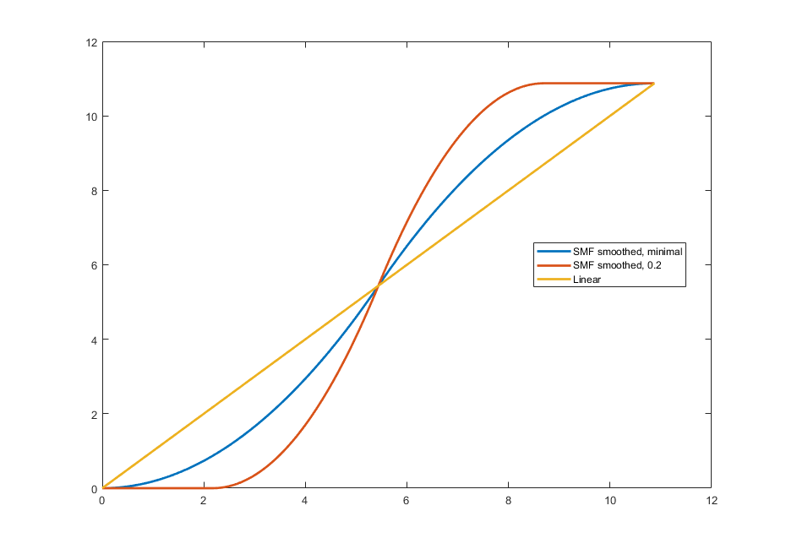
Trajectory Planning
Sigmoidal Membership Function
t’
t

Slide 17
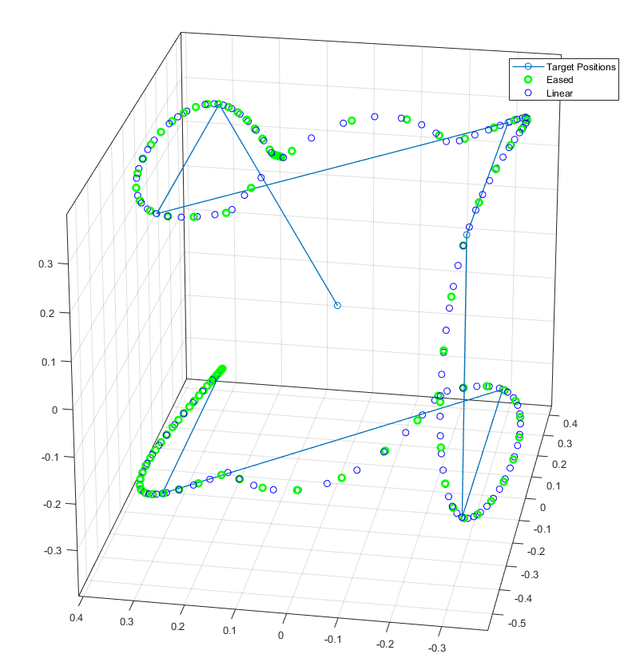
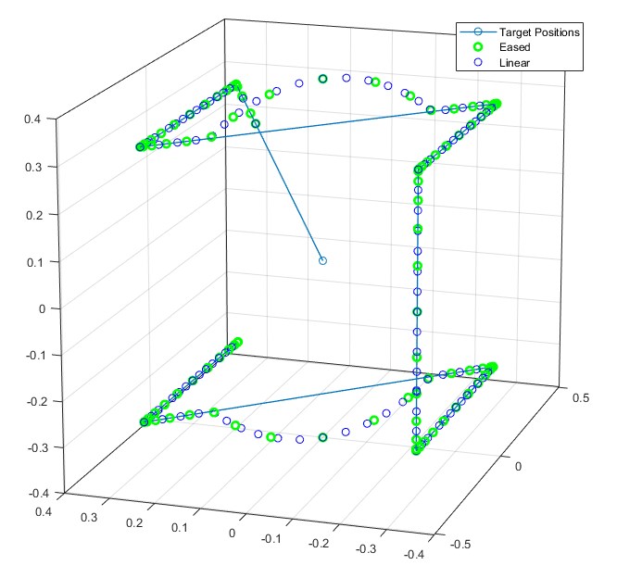
Trajectory Planning
Spline vs linear motion

Slide 18
Contents
Denavit–Hartenberg parameters
Forward Kinematics
Inverse Kinematics
Trajectory Planning
GUI & Simulink
Demonstration

Slide 19
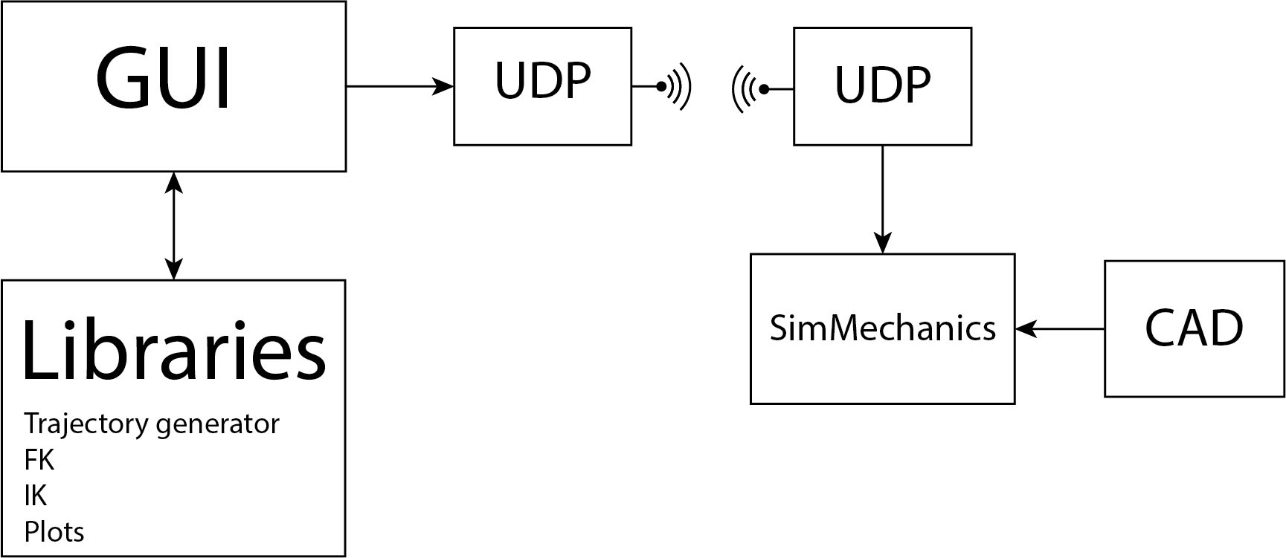
GUI & Simulink

Slide 20
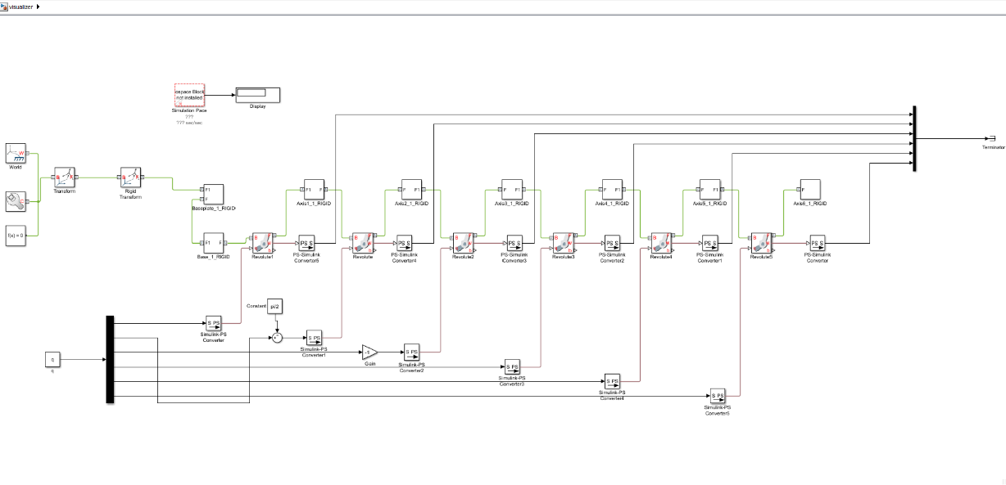
GUI & Simulink
Run IK for all locations

Slide 21
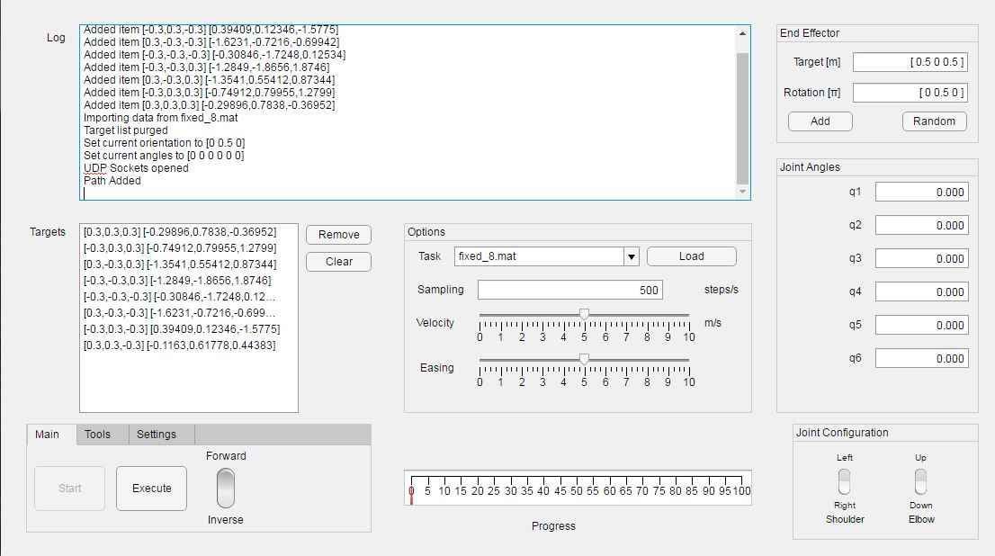
GUI & Simulink

Slide 22
GUI & Simulink
GUI runs FK, IK and other logic centrally
Sends q over UDP to a different Matlab instance running SimMechanics
Random points
Velocity
Easing
Elbow position
Plots

Slide 23
Contents
Denavit–Hartenberg parameters
Forward Kinematics
Inverse Kinematics
GUI & Simulink
Demonstration

Slide 24
Demonstration

Slide 25
Recommendations
Trajectory: use hybrid of joint and Cartesian space
Use optimization methods for trajectory planning
Optimize constraints (avoid self-collision)

